Slide 1
Cayuse IRB Training
Sharla Miles, M.Ed., CIP
Research Compliance Administrator
Research & Sponsored Programs

Slide 2
Cayuse IRB: Creating a New Study

Slide 3
Creating a New Study
FYI: CAYUSE IRB IS NOW ON SHSU FAST LINKS FROM SHSU HOMEPAGE!!
Step 1: To create a new study, click the New Study button in the upper right of either the Studies page or your Dashboard.

Slide 4
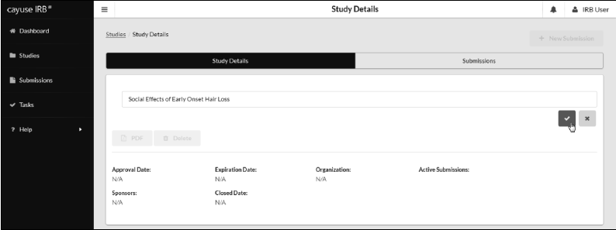
Creating a New Study (Cont’d)
Step 2: Enter a title for your study (up to 600 characters). Then, click the Save button.
Step 2-a: After creating the new study, you will be taken to the Study Details page.
Note on Editing Study Titles: You can choose to rename your study at any point up until the initial (or a withdrawal) submission has finished being reviewed. From the Study Details screen, click anywhere within the study title field to edit the title.

Slide 5
Cayuse IRB: Creating Initial Submission

Slide 6
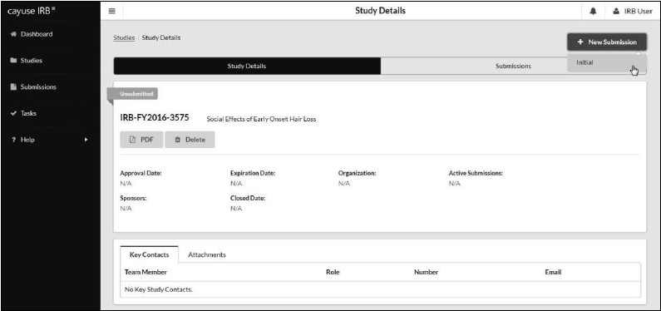
Creating the Initial Submission
Step 3: To begin working on your study, click New Submission to add the Initial submission for your study.

Slide 7
Creating the Initial Submission (cont’d)
Step 4: The initial submission appears below the study details. The person who creates the study is added as the PC by default. Click the Edit button to begin working on the initial submission.

Slide 8
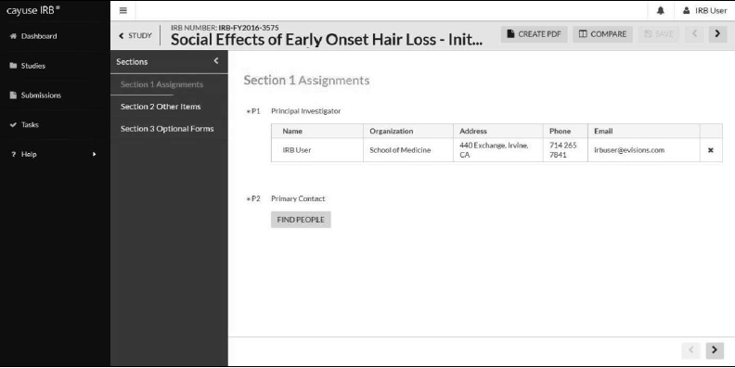
Creating the Initial Submission (cont’d)
Step 5: You will now be taken to your institution's initial submission form, where you can begin filling out the requested information.

Slide 9
Cayuse IRB: Completing Initial Submission

Slide 10
Completing Initial Submission
The section you are currently working on appears in the menu in green text. As you provide information, the status bar underneath the section turns green. When complete, the section name has a green check mark to its right.
Use the < and > buttons to navigate to the previous and next sections. You can also click on a section name in the menu at left to jump to that section.

Slide 11
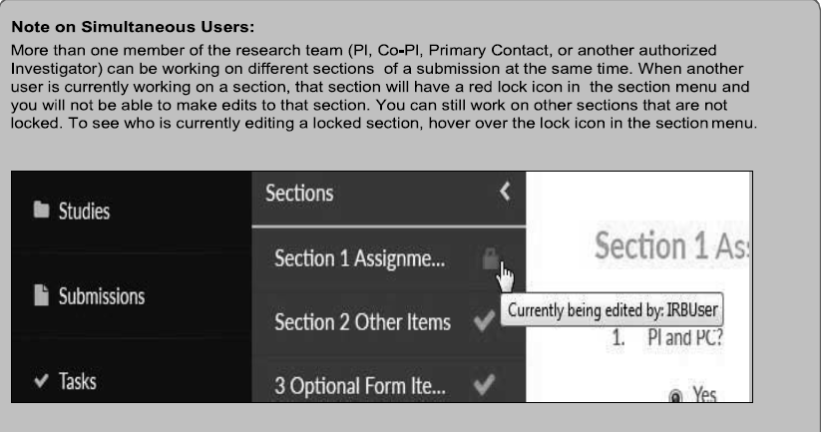

Slide 12
Types of Questions – Initial Submission
Radio Buttons: Select one of the available options.
Check Boxes: Select one or more of the available options.
Text Box: provides space for a short answer that does not require a lot of explanation. You can enter multiple lines of text here if needed; the box will expand to fit the text.
Text Area: The multi-line text editor allows you to apply simple text formatting such as bold, italics, underline, strikethrough, bulleted lists, numbered lists, and hyperlinks.
Person and Sponsor Finders: allow you to search for personnel or sponsors to add to your submission. [See next slides for further directions]
Attachments: Attachment fields allow you to upload one or more files to the study, or to include hyperlinks as "attachments". [See next slides for further directions]

Slide 13
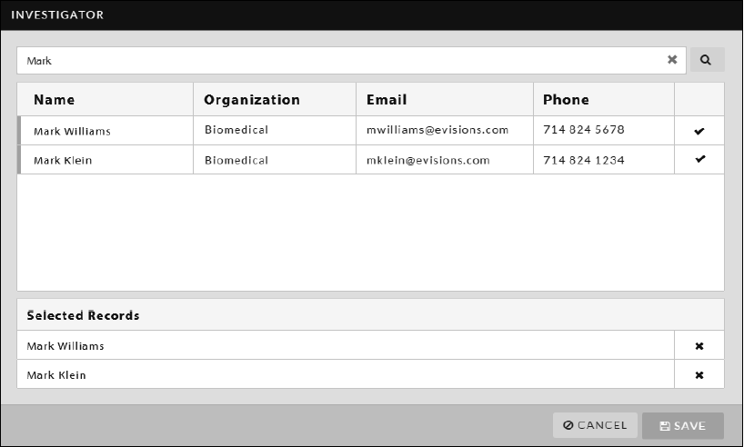
Types of Questions – Person finders
Some fields require a single person, such as the Primary Contact for a study.
DO NOT DELETE PRIMARY CONTACT PERSON FROM YOUR SUBMISSION!
Other People finders allow you to select more than one person.
When you add a person to the selection, the + button changes to a check mark.
Types of Questions – Sponsor Finder
Works the same way as Person finders, except that the search returns matching sponsors instead of people.

Slide 14
Types of Questions – Attachments
Click Attach to open the Documents window. To add a file or link, click the + button and choose to add a URL or file.
Choosing Add File launches the default file browser on your system.

Slide 15
Help With Questions
If there is help text for a particular question, you can click on the (?) button to the right of that question to view additional information.

Slide 16
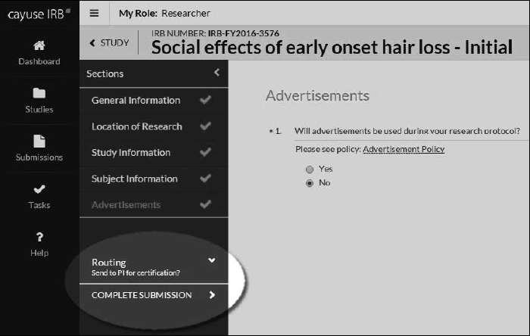
Completing Your Submission - Workflow
Routing: when you finish filling out all parts of the submission, a "Complete Submission" link appears in the Routing menu. Completing the submission will send it to the PI for certification, which is the next step in the submission workflow.
Note: depending
on number of
sections, you may
need to scroll
to find the
“Complete
Submission” link.

Slide 17
Certifying Your Submission – Workflow (cont’d)
Next step before routing begins: Certify your submission
To do so, on your Submission Details page, click Certify (see screen shot below)

Slide 18
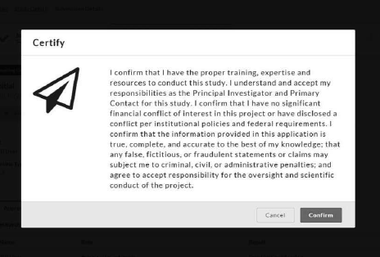
Certifying Your Submission – Workflow (cont’d)
If everything is correct, the PI “and” Co-PI must then Certify the submission. By certifying the submission, the PI and Co-PI assert that the submission is complete and accurate, and that they accept their responsibilities as PI and Co-PI of the study.

Slide 19
Pre-Review/Under Review – Addressing Comments
The email address IRB system notifications will be sent from orsp@irb.shsu.edu.
If the submission gets returned to you, you will see a comment icon in the sidebar next to each section that contains comments, and a similar icon underneath the questions that have comments on them. Click the link to see and respond to these comments.
After responding to a comment, change the drop down from Unaddressed to Addressed. Unaddressed comments have a red bar to their left, and display the comment count in the comment bubble icon for that question. You can toggle comments between addressed and unaddressed as needed.

Slide 20
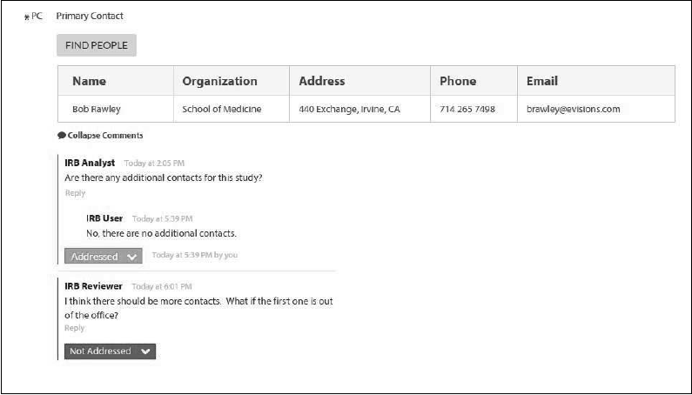
Once all comments on the submission have been addressed, the PI (or Co-PI, depending on your institution's settings) will need to re-certify the submission to return it to the IRB Analyst.

Slide 21
Cayuse IRB Takeaways

Slide 22
Which button in Cayuse IRB do you click on to Start a New Study?
A.
B.
C.
D.

Slide 23
Who are the Org Approvers at SHSU?
Faculty Sponsor and Co-PI
PI and Co-PI
President Hoyt and CAD
Chair and Dean

Slide 24
The Modification Submission Type is new terminology for Amendment
TRUE
FALSE

Slide 25
Which button in Cayuse IRB do you click on to Start your Initial Submission?
A.
B.
C.
D.

Slide 26
THE WEBSITE URL FOR ACCESSING CAYUSE IRB IS https://shsu.cayuse424.com/.
TRUE
FALSE

Slide 27
GREAT JOB EVERYONE!!!!!!
CONTACT INFORMATION: SHARLA MILES, IRB@SHSU.EDU, 4-4875, THO 303A

